Slide 1
RNA Secondary structure prediction using Stochastic context free grammars
Sudhanshu Bharadwaj

Slide 2

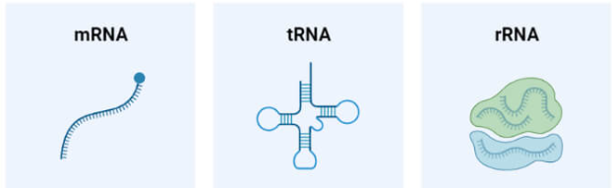
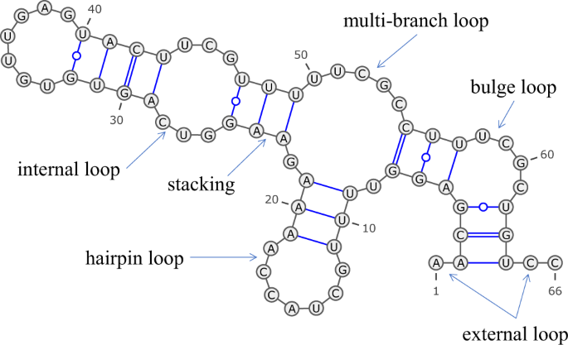
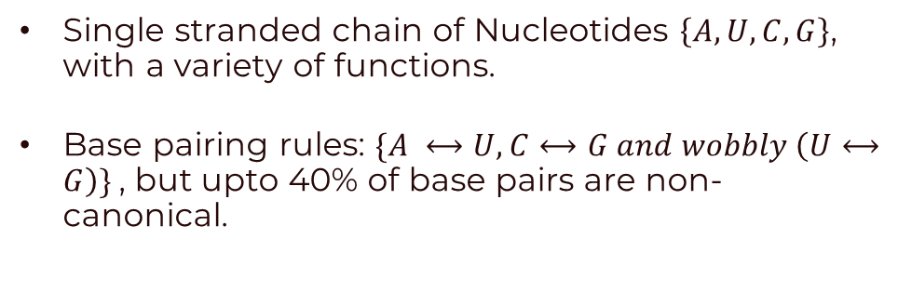
The Biology of RNA
Single stranded chain of Nucleotides $\left\{A,U,C,G\right\}$, with a variety of functions.
Base pairing rules: $\{A ⟷U,C⟷G and wobbly \left(U⟷G\right)\}$, but upto 40% of base pairs are non-canonical.
This leads to RNA adopting various secondary structures
Knowing these secondary structures is important to predict function and sometimes sufficient for our purposes.

Slide 3
So How do we predict these structures?
Given a sequence of RNA nucleotides, can we predict where secondary structural motifs will occur?

Slide 4

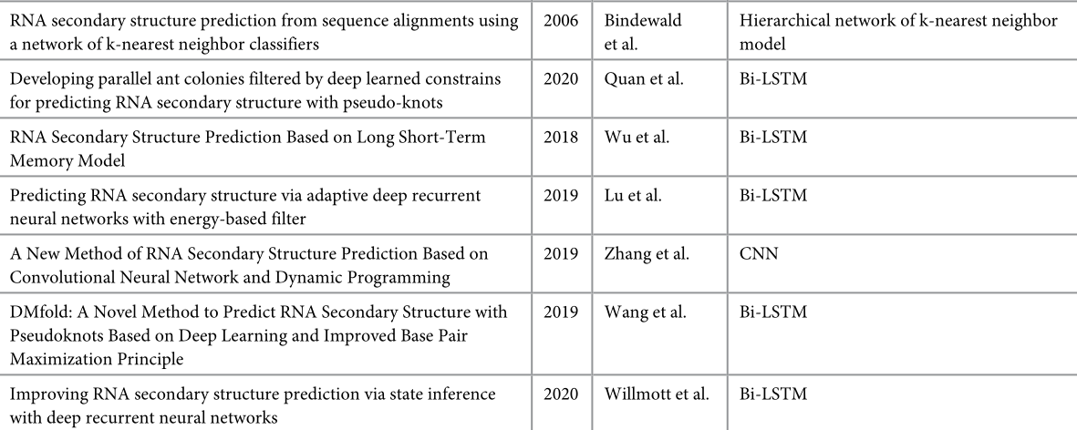
So How do we predict these structures?
Given a sequence of RNA nucleotides, can we predict where secondary structural motifs will occur?

Slide 5
So How do we predict these structures?
Given a sequence of RNA nucleotides, can we predict where secondary structural motifs will occur?
More interpretable classical algorithms
Minimize the overall energy : Zuker Algorithm
Maximize the number of base pairings : Nussinov Algorithm
Using Stochastic Context free grammars?
(Note: Pseudonots are a secondary structure that all the above methods cannot take into consideration)

Slide 6
Stochastic context free grammars?
A small detour

Slide 7
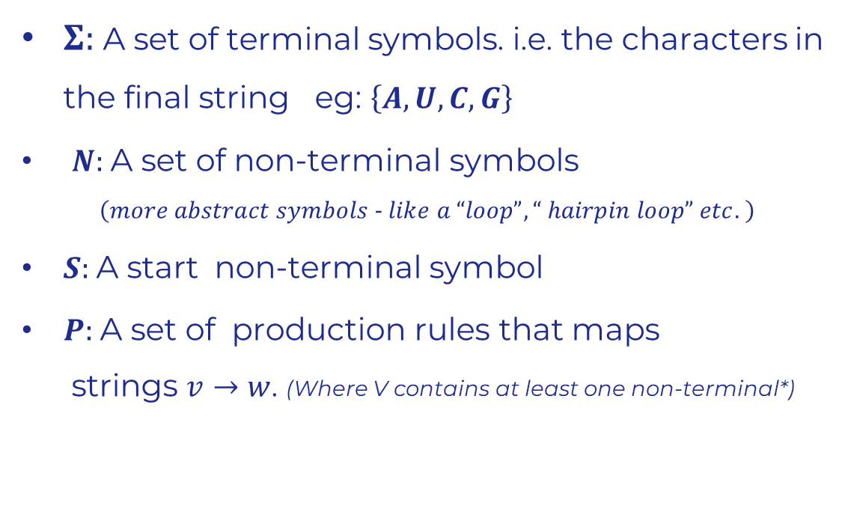
grammars
Generative
$Σ:$A set of terminal symbols. i.e. the characters in the final string eg: $\left\{A,U,C,G\right\}$
$N:$A set of non-terminal symbols $\left(more abstract symbols − like a “loop”, “ hairpin loop” etc. \right)$
$S:$A start non-terminal symbol
$P:$A set of production rules that maps strings $v→w$. (Where V contains at least one non-terminal*)

Slide 8
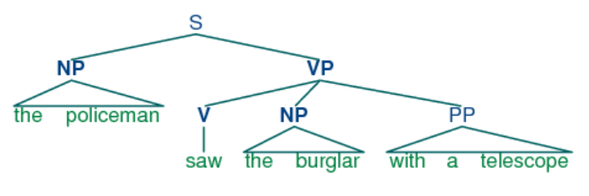
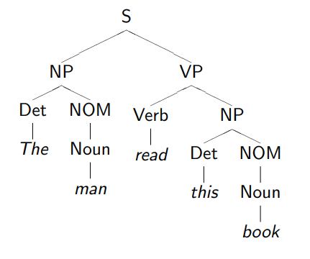
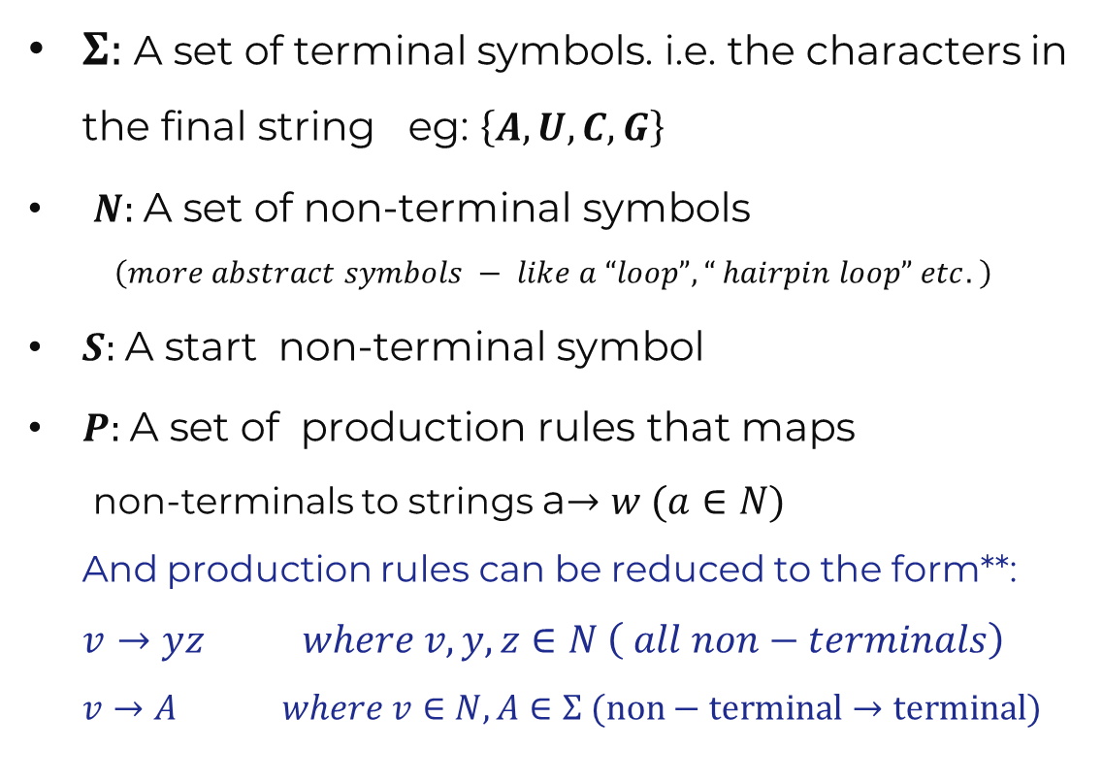
grammars
Context-Free
$Σ:$A set of terminal symbols. i.e. the characters in the final string eg: $\left\{A,U,C,G\right\}$
$N:$A set of non-terminal symbols $\left(more abstract symbols − like a “loop”, “ hairpin loop” etc. \right)$
$S:$A start non-terminal symbol
$P:$A set of production rules that maps non-terminals to strings a$→w (a∈N)$ And production rules can be reduced to the form**: $v→yz where v,y,z∈N \left( all non−terminals\right)$ $v→A where v∈N, A∈Σ (non−terminal→terminal)$

Slide 9
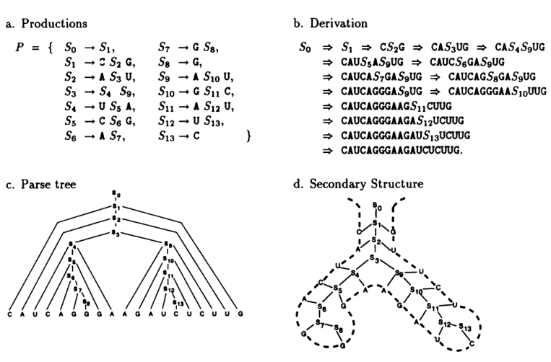
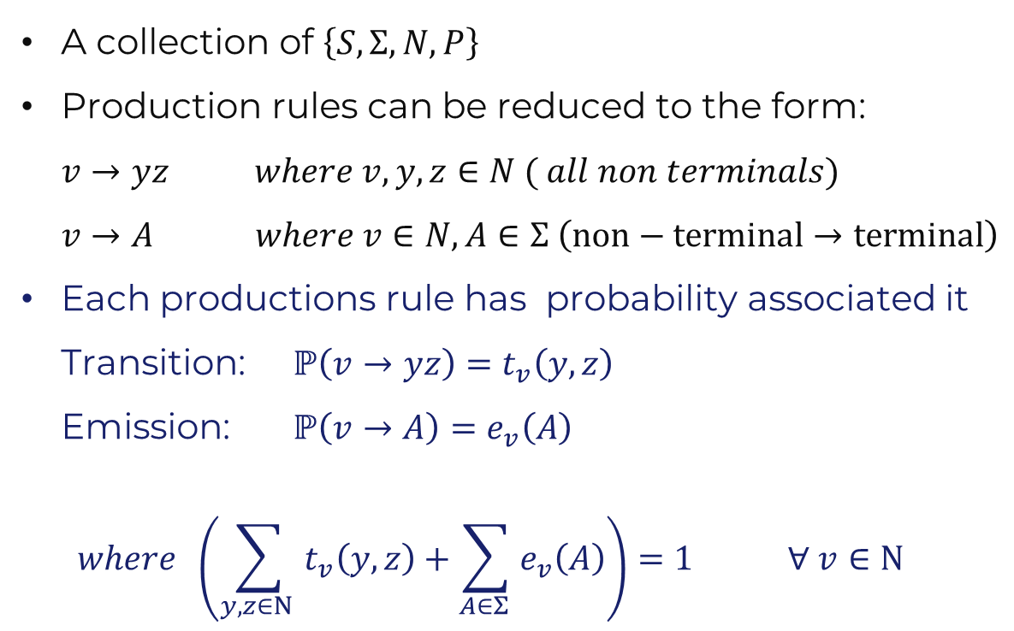
Stochastic Context-Free Grammars
A collection of $\left\{S,Σ, N, P\right\}$
Production rules can be reduced to the form: $v→yz where v,y,z∈N ( all non terminals)$ $v→A where v∈N, A∈Σ \left(non−terminal→terminal\right)$
Each productions rule has probability associated it Transition: $ℙ\left(v→yz\right)=t_{v}\left(y,z\right)$ Emission: $ℙ\left(v→A\right)=e_{v}\left(A\right)$ $where \left(\sum_{y,z∈N }{t_{v}\left(y,z\right)}+\sum_{A∈Σ }{e_{v}\left(A\right)}\right)=1 ∀ v∈N$
Notes:
This is very much like a Hidden Markov Model. Take example here of rules

Slide 10
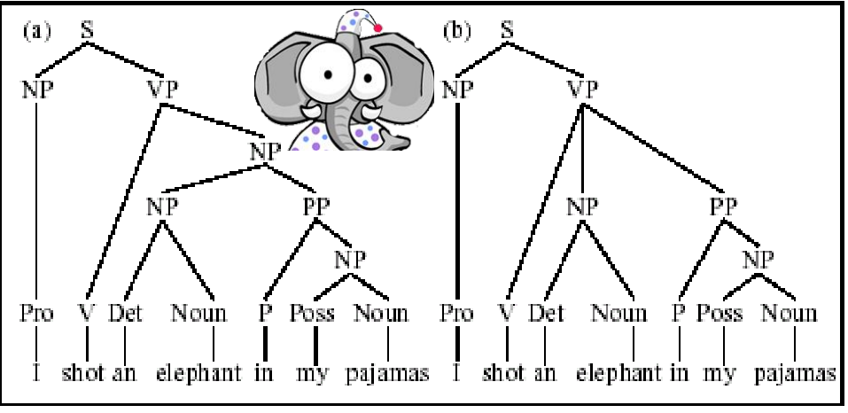
Ambiguity in Parsing
Different sets of rules can give rise to the same sequence.

Slide 11
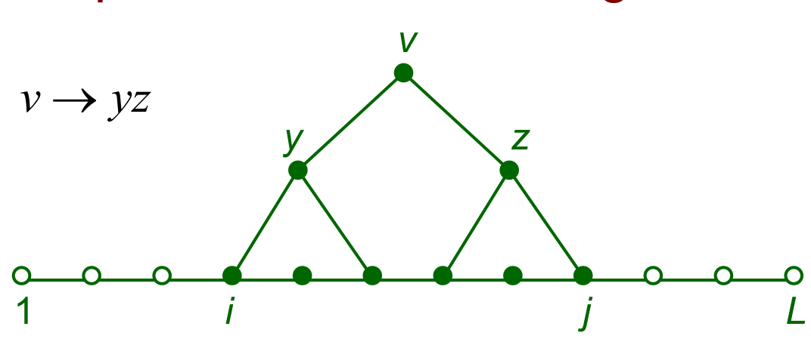

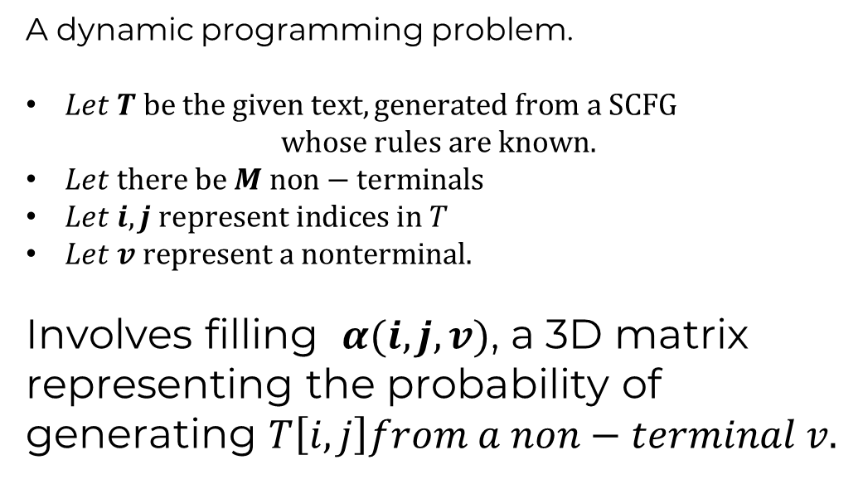
How likely is a given sequence? The Inside algorithm.
A dynamic programming problem.
$Let T be the given text, generated from a SCFG$ $whose rules are known.$
$Let there be M non−terminals$
$Let i,j represent indices in T$
$Let v represent a nonterminal.$
Involves filling $α(i,j,v)$, a 3D matrix representing the probability of generating $T\left[i,j\right]from a non−terminal v.$

Slide 12
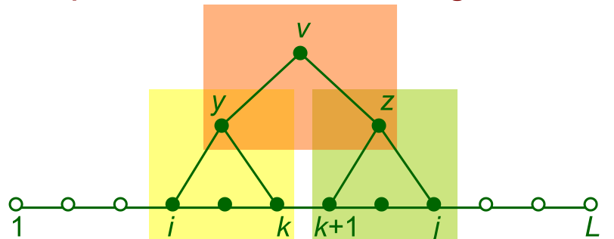
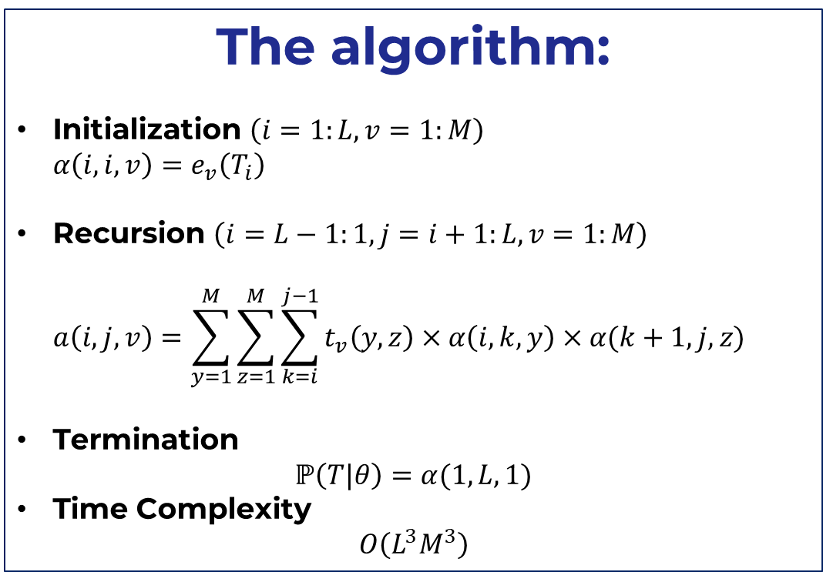
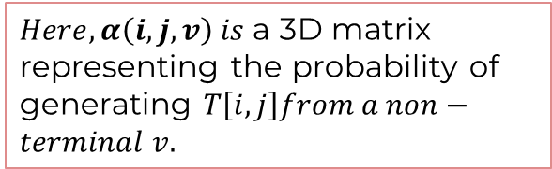
How likely is a given sequence? The Inside algorithm.
The algorithm:
Initialization $\left(i=1:L, v=1:M\right)$ $α\left(i,i,v\right)=e_{v}\left(T_{i}\right)$
Recursion $\left(i=L−1:1, j=i+1:L,v=1:M\right)$ $a\left(i,j,v\right)=\sum_{y=1}^{M}{\sum_{z=1}^{M}{\sum_{k=i}^{j−1}{t_{v}\left(y,z\right)×α\left(i,k,y\right)×α(k+1,j,z)}}}$
Termination $ℙ\left(T|θ\right)=α(1,L,1)$
Time Complexity $O\left(L^{3}M^{3}\right)$
$Here, α\left(i,j,v\right) is$a 3D matrix representing the probability of generating $T\left[i,j\right]from a non−terminal v.$
Notes:
Complexity = O(L^3 M^3)

Slide 13
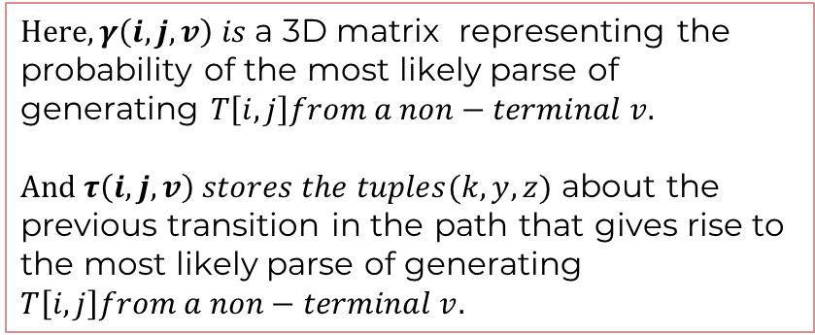
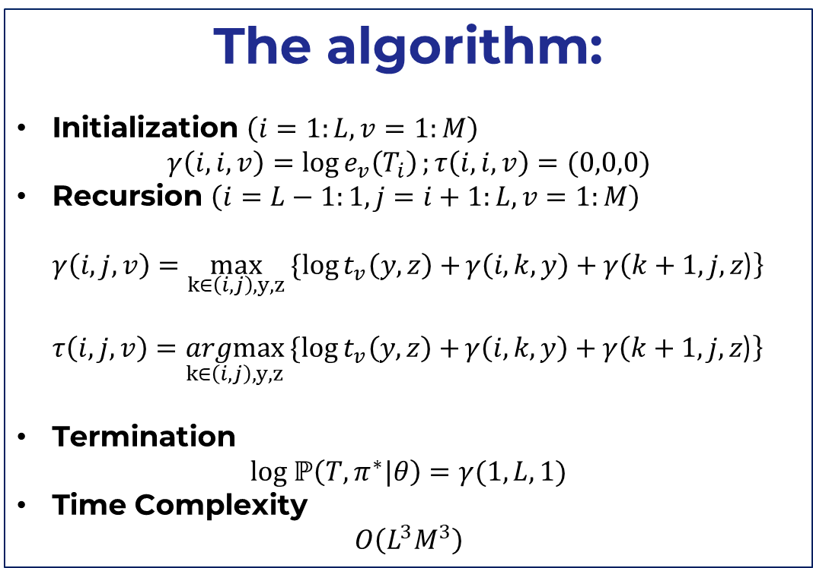
What is the most likely parse for a sequence? The CYK algorithm
The algorithm:
Initialization $\left(i=1:L, v=1:M\right)$ $γ\left(i,i,v\right)=\log{e_{v}\left(T_{i}\right)};τ\left(i,i,v\right)=(0,0,0)$
Recursion $\left(i=L−1:1, j=i+1:L,v=1:M\right)$ $γ\left(i,j,v\right)=\max_{k∈\left(i,j\right), y,z}{\{\log{t_{v}\left(y,z\right)+}γ\left(i,k,y\right)+γ\left(k+1,j,z\text{)}\right\} }$ $τ\left(i,j,v\right)=\underset{k∈\left(i,j\right), y,z}{argmax}{\{\log{t_{v}\left(y,z\right)+}γ\left(i,k,y\right)+γ\left(k+1,j,z\text{)}\right\} }$
Termination $log ℙ\left(T,π^{∗}|θ\right)=γ(1,L,1)$
Time Complexity $O\left(L^{3}M^{3}\right)$
$Here, γ\left(i,j,v\right) is$a 3D matrix representing the probability of the most likely parse of generating $T\left[i,j\right]from a non−terminal v.$ $And τ\left(i,j,v\right) stores the tuples(k,y,z)$ about the previous transition in the path that gives rise to the most likely parse of generating $T\left[i,j\right]from a non−terminal v.$

Slide 14
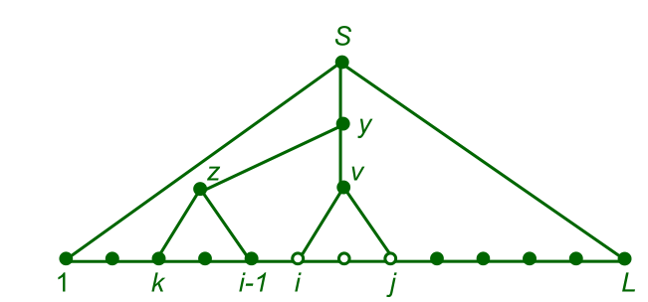


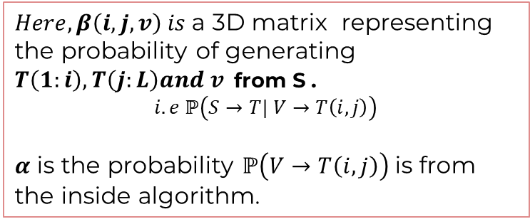
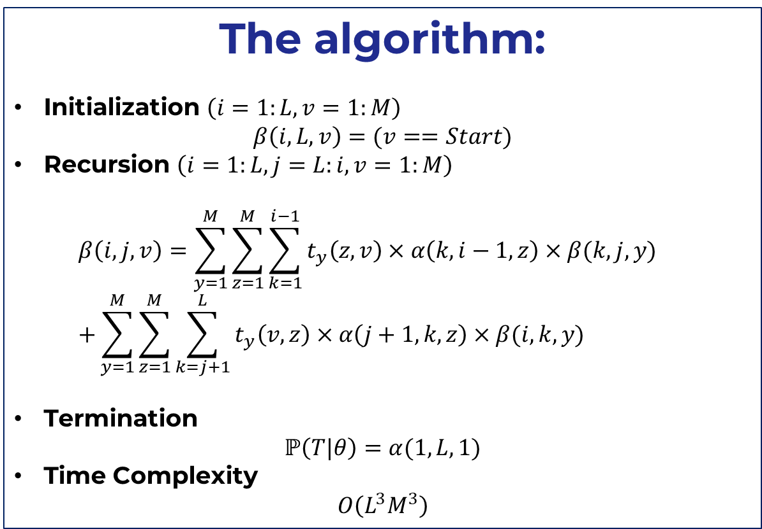
(Will be important later: For reference) The Outside algorithm.
The algorithm:
Initialization $\left(i=1:L, v=1:M\right)$ $β\left(i,L,v\right)=(v==Start)$
Recursion $\left(i=1:L, j=L:i,v=1:M\right)$ $β\left(i,j,v\right)=\sum_{y=1}^{M}{\sum_{z=1}^{M}{\sum_{k=1}^{i−1}{t_{y}\left(z,v\right)×α\left(k,i−1,z\right)×β(k,j,y)}}}$ $+\sum_{y=1}^{M}{\sum_{z=1}^{M}{\sum_{k=j+1}^{L}{t_{y}\left(v,z\right)×α\left(j+1,k,z\right)×β(i,k,y)}}}$
Termination $ℙ\left(T|θ\right)=α(1,L,1)$
Time Complexity $O\left(L^{3}M^{3}\right)$
$$when \\ y→zv$$
$$when \\ y→v,z$$
$Here, β\left(i,j,v\right) is$a 3D matrix representing the probability of generating $T\left(1:i\right), T\left(j:L\right)and v$from S . $$i.e ℙ\left(S→T| V→T\left(i,j\right)\right)$$
$α$ is the probability $ℙ\left(V→T\left(i,j\right)\right)$ is from the inside algorithm.
Notes:
Complexity = O(L^3 M^3)

Slide 15
How does one learn these grammar rules and their probabilities?
But perhaps the most import question…
A lot of latent variables: Non-terminals are not observable, therefore one can’t use simple parameter estimation techniques.
Expectation Maximization: An ideal method to estimate parameters when there are a lot of latent parameters.

Slide 16
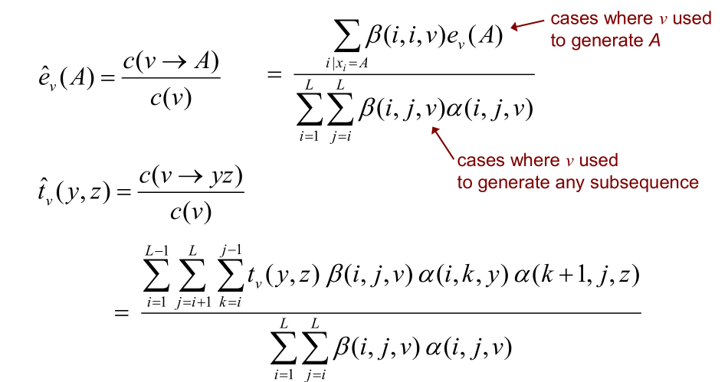
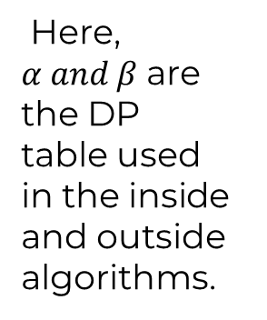
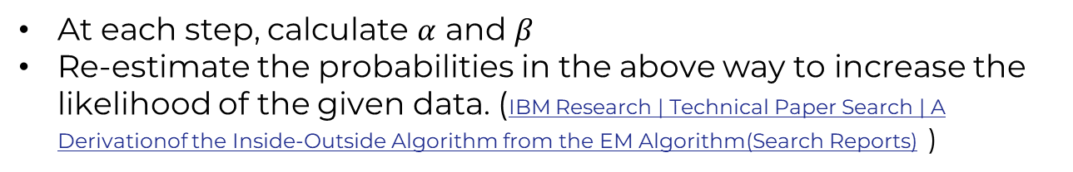
THE Inside-Outside Algorithm
Here, $α and β$are the DP table used in the inside and outside algorithms.
At each step, calculate $α$ and $β$
Re-estimate the probabilities in the above way to increase the likelihood of the given data. (IBM Research | Technical Paper Search | A Derivationof the Inside-Outside Algorithm from the EM Algorithm(Search Reports) )

Slide 17
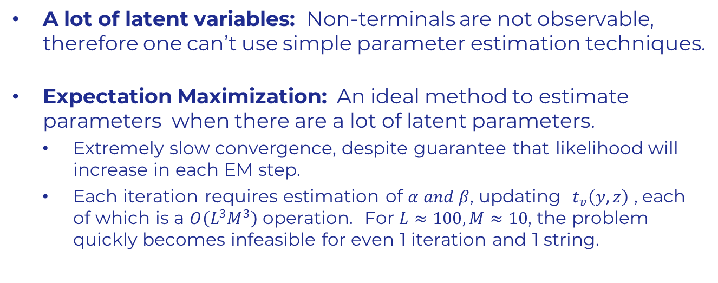
How does one learn these grammar rules and their probabilities?
But perhaps the most import question…
A lot of latent variables: Non-terminals are not observable, therefore one can’t use simple parameter estimation techniques.
Expectation Maximization: An ideal method to estimate parameters when there are a lot of latent parameters.
Extremely slow convergence, despite guarantee that likelihood will increase in each EM step.
Each iteration requires estimation of $α and β$, updating $t_{v}\left(y,z\right)$ , each of which is a $O\left(L^{3}M^{3}\right)$ operation. For $L≈100, M≈10$, the problem quickly becomes infeasible for even 1 iteration and 1 string.

Slide 18

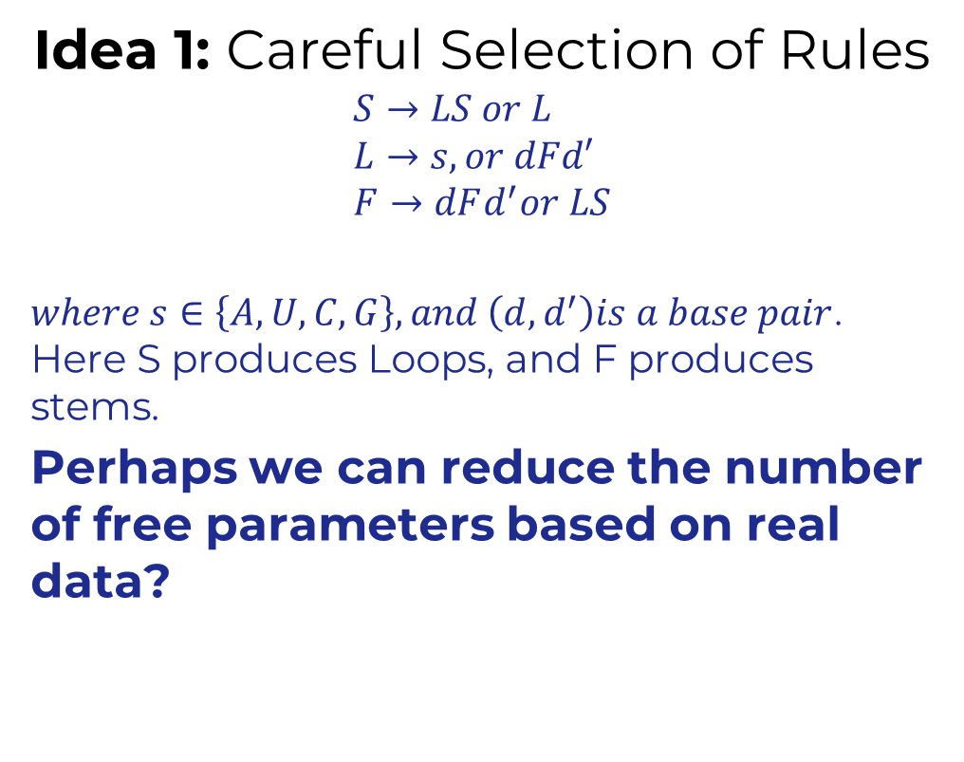
better estimation OF SCFG parameters?
Idea 1: Careful Selection of Rules
$$S→LS or L \\ L→s, or dFd′ \\ F→dFd^{′}or LS$$
$where s∈\left\{A,U,C,G\right\}, and \left(d,d^{′}\right)is a base pair$. Here S produces Loops, and F produces stems.
Perhaps we can reduce the number of free parameters based on real data?
Notes:
So, the math seemed to be a little distracting from the key idea, and because of time constraints….

Slide 19
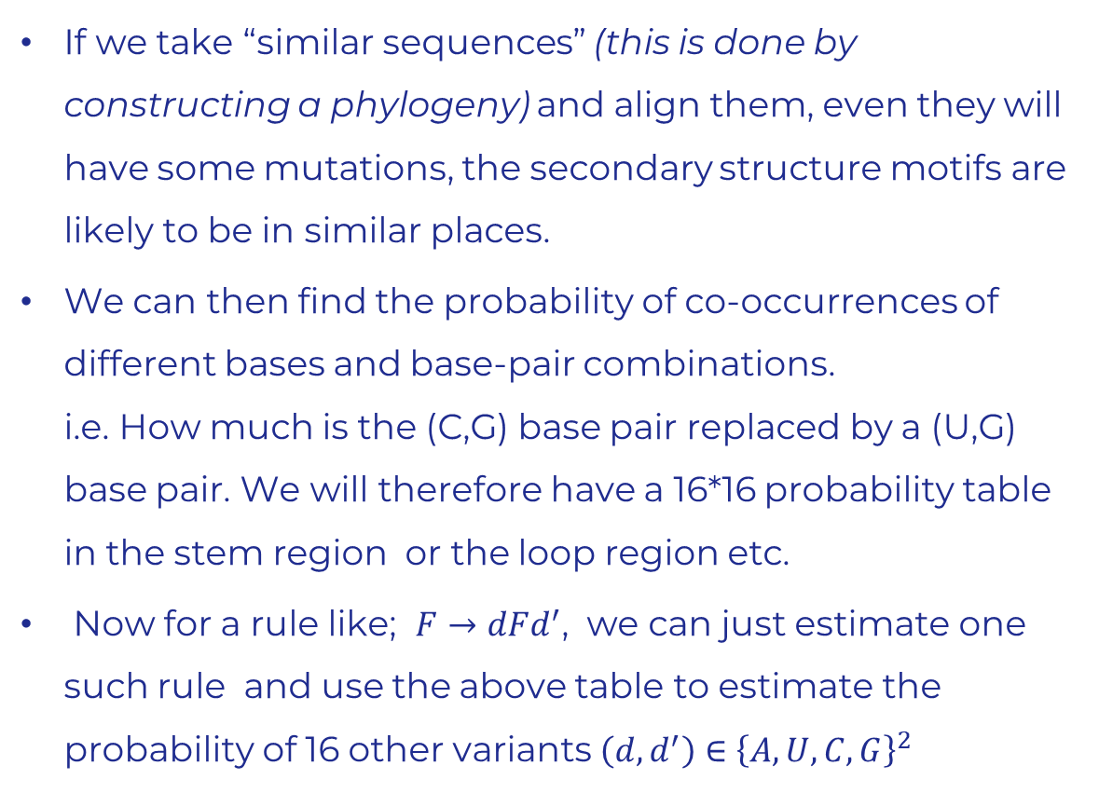
Idea 2: Using similar sequences
If we take “similar sequences” (this is done by constructing a phylogeny) and align them, even they will have some mutations, the secondary structure motifs are likely to be in similar places.
We can then find the probability of co-occurrences of different bases and base-pair combinations. i.e. How much is the (C,G) base pair replaced by a (U,G) base pair. We will therefore have a 16*16 probability table in the stem region or the loop region etc.
Now for a rule like; $F→dFd^{′}$, we can just estimate one such rule and use the above table to estimate the probability of 16 other variants $\left(d,d^{′}\right)∈{\left\{A,U,C,G\right\}}^{2}$

Slide 20
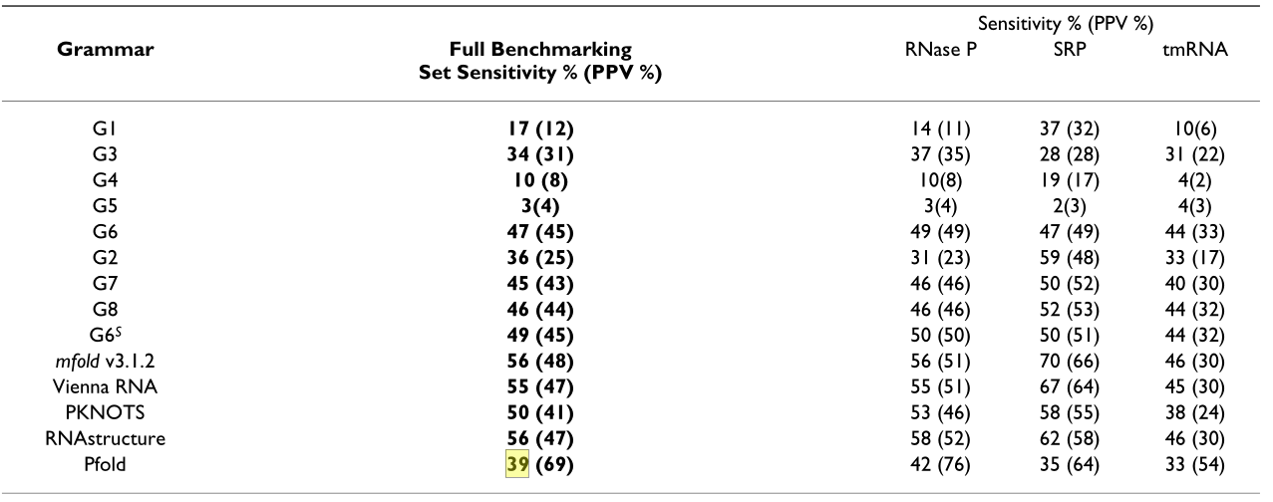
Experiments with real data
As said earlier, current approaches use Deep Learning based methods. Therefore, it was hard to find a good implementation of the above method online.
Will finish implementation and show its results in the report (Or present for about 5 minutes on Monday, if that’s possible)
Small code demo?

Slide 21
THANK YOU
Sudhanshu B
sudhanshub@iisc.ac.in
Main References:
Bjarne Knudsen and Jotun Hein. Pfold: RNA secondary structure pre-diction using stochastic context-free grammars. Nucleic Acids Research,31(13):3423–3428, 07 2003
Several figures have been borrowed from Andrew McCallum and Anthony Gitter slides]

